Slide 1

Department of Computer Science Gujarat University
M.Sc.(Artificial Intelligence & Machine Learning) –
Defence Specific – III
Movie Recommendation Engine
Presented By:
Vickey Patel (10)
Priyank Shimpy(DS – 04)
Under the Guidance of :
Mr. Ankan Majumdar

Slide 2

What is Recommendation Engine?
Recommender Engine is techniques that provide suggestions for items that are most likely of interest to a particular user. The suggestions relate to various decision-making processes, such as what items to buy, what music to listen to, or what online news to read.
“Item” is the general term used to denote what the system recommends to users. An RE normally focuses on a specific type of item (e.g., CDs or news) and, accordingly its design, its graphical user interface, and the core recommendation technique used to generate the recommendations are all customized to provide useful and effective suggestions for that specific type of item.

Slide 3
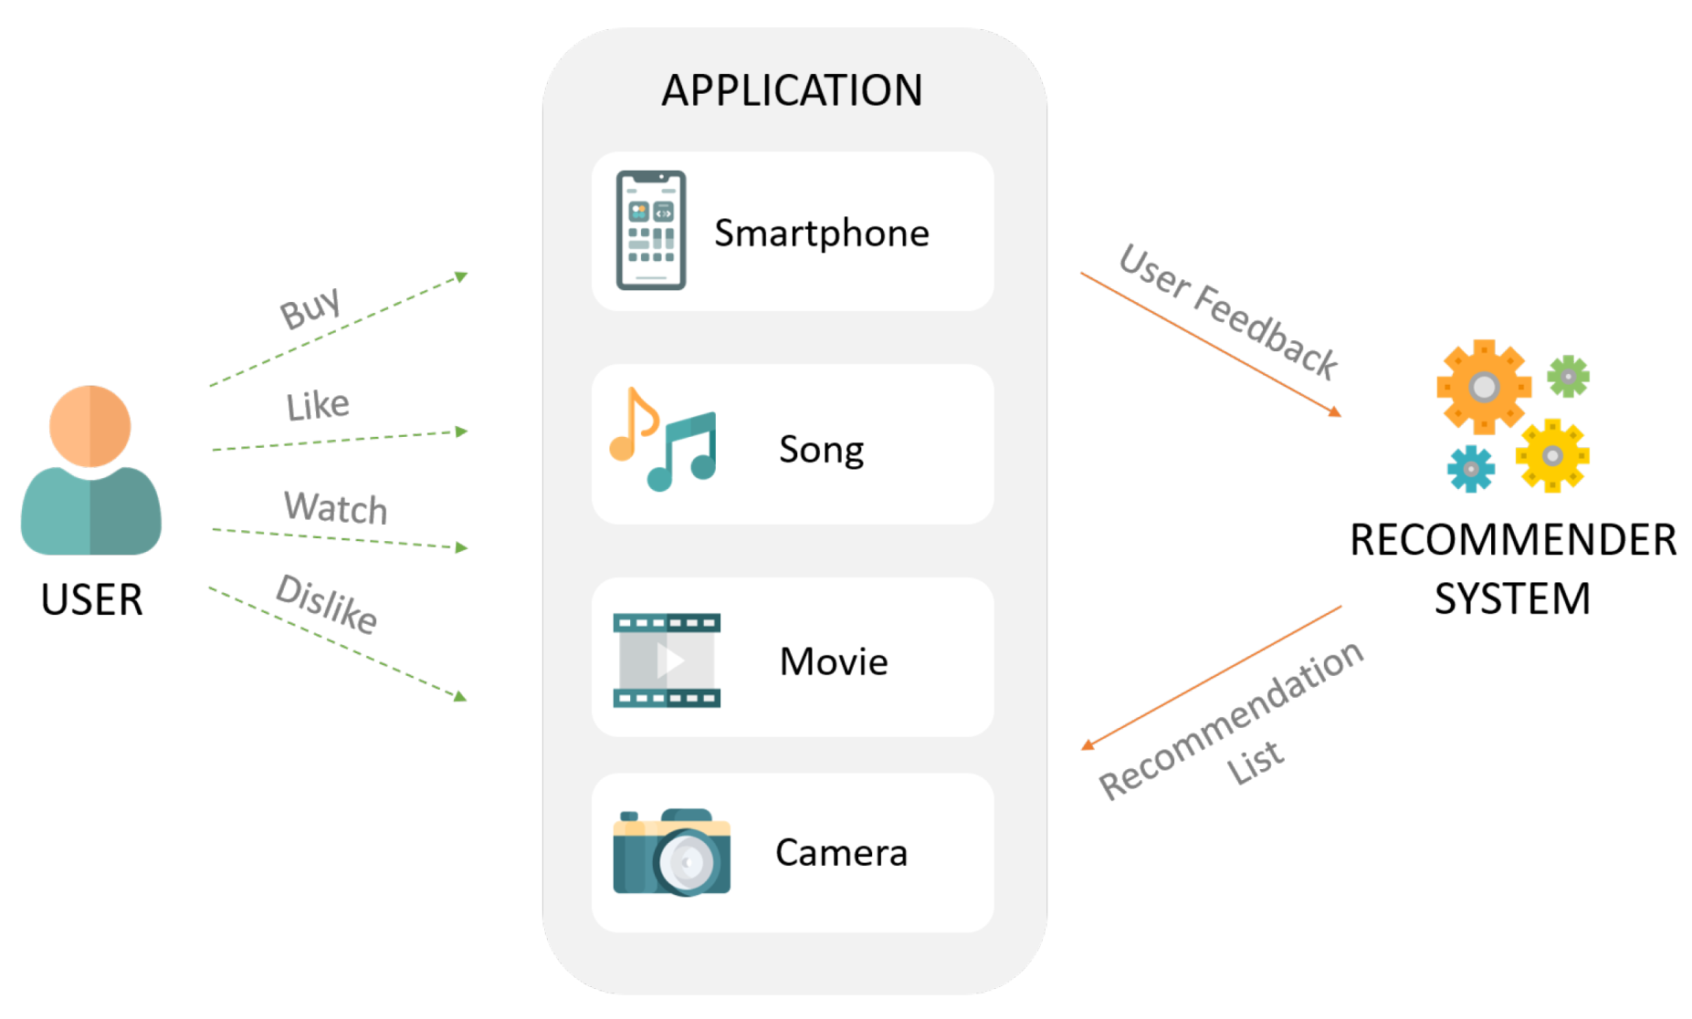
Recommendation System

Slide 4
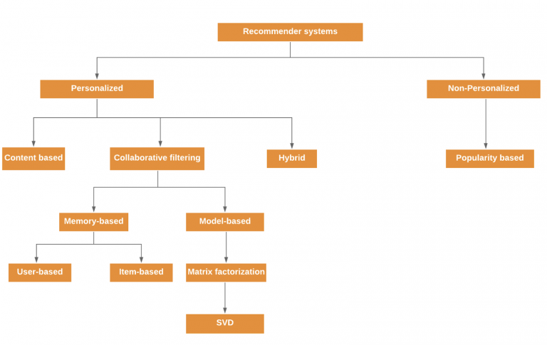
Recommendation Techniques

Slide 5
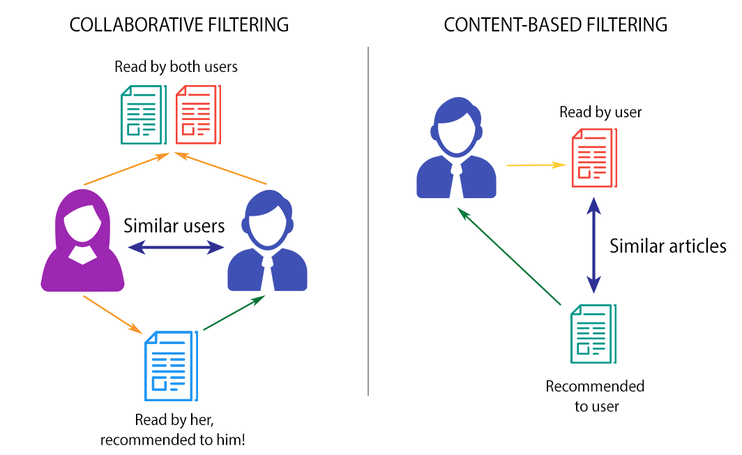
Recommendation Techniques

Slide 6
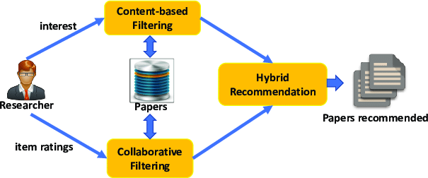
Recommendation Techniques
Hybrid Recommendation Systems - Hybrid Recommender Systems These RS s are based on the combination of the above mentioned techniques. A hybrid system combining techniques A and B tries to use the advantages of A to fix the disadvantages of B. For instance, CF methods suffer from new-item problems, or, that they cannot recommend items that have no ratings. This does not limit content-based approaches since the prediction for new items is based on their description (features) that are typically easily available. Given two (or more) basic RSs techniques, several ways have been proposed for combining them to create a new hybrid.

Slide 7
Examples of Recommender system.
• Entertainment—recommendations for movies, music, games, and IPTV.
• Content—personalized newspapers, recommendation for documents, recommendations of webpages, e-learning applications, and e-mail filters.
• E-commerce—recommendations of products to buy such as books, cameras, PCs etc. for consumers.
• Services—recommendations of travel services, recommendation of experts for consultation, recommendation of houses to rent, or matchmaking services.
• Social—recommendation of people in social networks, and recommendations of content social media content such as tweets, Facebook feeds, LinkedIn updates, and others.
• Netfilx is a good example of hybrid systems. They make recommendations by comparing the watching and searching habits of similar users (collaborative filtering) as well as by offering movies that share characteristics with films that a user has rated highly (content-based filtering).

Slide 8
Tools and Technologies
Machine Learning: Machine Learning algorithms such as collaborative filtering, content-based filtering, and hybrid approaches are used to build the movie recommendation system. Natural Language Processing:
NLP techniques, such as sentiment analysis and text classification, can be used to analyze user feedback and reviews to determine user preferences.
Technologies:
Web Technologies: Python flask, HTML, CSS, JavaScript web technologies are used to build the user interface for the system
Hardware Requirements: A PC with Windows/Linux OS , Processor with 1.7-2.4gHz speed ,Minimum of 8gb RAM ,2gb Graphic card
Software Specification: VS-code , Anaconda distribution package (Jupyter notebook), Python libraries(Flask ,Jinja2, numpy, scipy,nltk,scikitlearn,pandas,beautifulsoup4,jsonschema.tmdbv3api.lxml,urllib3requests,pickleshare)

Slide 9
 | Advantages | Disadvantages
Content based | No need for users access history data. No new item problem and no sparsity problem | Limited by the features extraction methods. New user problem. The training of classifier needs massive data.. Need more data.
Collaboration filtering | No need for professional knowledge. Performance improving as the increasing of the user number Automatic. Complex unstructured item can be processed. eg. Music, Video, etc | Sparsity problem. Poor scalability. New user and new item problem. The recommendation quality limited by the history data set.
Hybrid Recommendation system | The recommendation accuracy is usually higher in hybrid systems. Make system robust, improve performance. Improve sparsity | A little complex to apply on same dataset. Increase complexity, expensive in implementation.

Slide 10
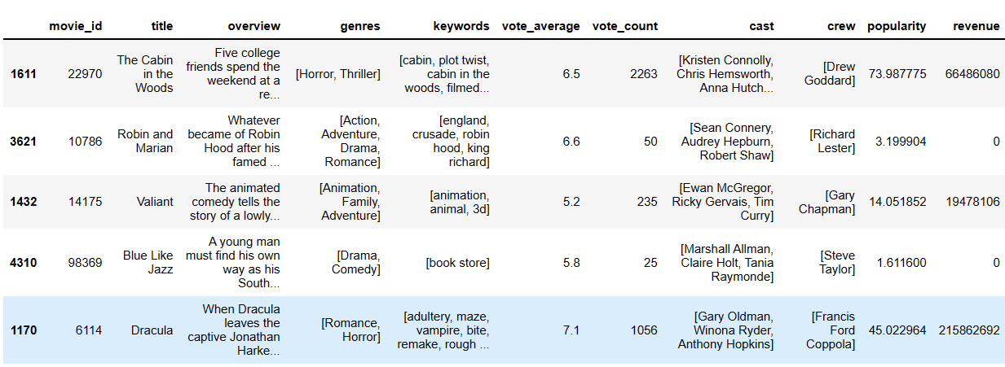
Dataset Usage
The Movie Database (TMDB). The dataset contains information on over 5,000 movies and 5000 credits including title, cast, crew, budget, revenue, and release date.
Dataset consist: 5000 Movies and 5000 credits are listed along with features include
Genres: listed along with their ( Action, Adventure, Animation, Children‘s, Comedy, Crime, Documentary, Drama, Fantasy, Film-Noir, Horror, Musical, Mystery, Romance, Sci-Fi, Thriller, War, Western. )

Slide 11
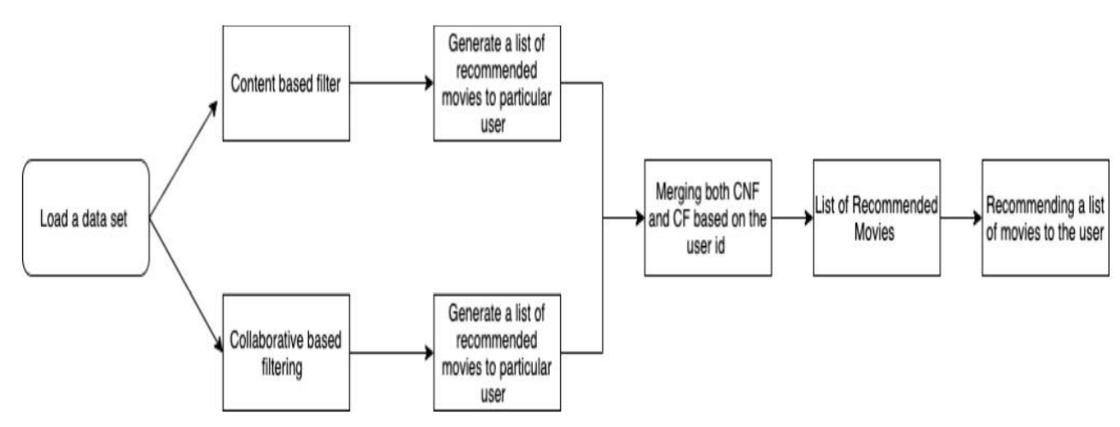
Data Flow

Slide 12
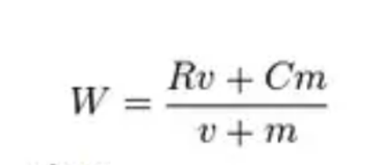
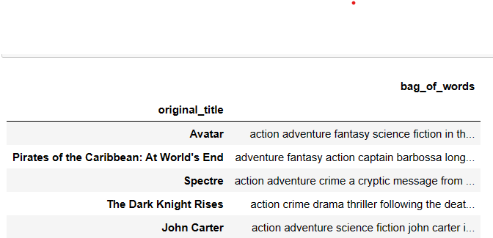
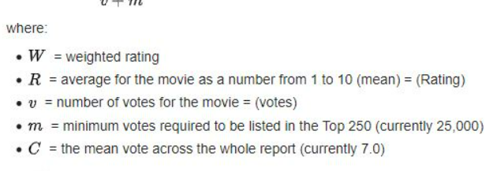
Weighted Average
If we see the dataset we had, there are tons of valuable information such as genre, overview, etc. Later, we are going to use this information to make our recommender system more robust. we extract those information inside bag of words then combined it with weighted average to get the final similarity for the movies

Slide 13
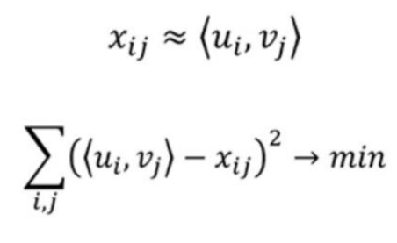
Matrix Decomposition for Recommendations
In this approach uses matrix decompositions. It‘s a very elegant recommendation algorithm because usually, when it comes to matrix decomposition, we don‘t give much thought to what items are going to stay in the columns and rows of the resulting matrices. But using this recommender engine, we see clearly that u is a vector of interests of the ithe user, and v is a vector of parameters for j-th film.

Slide 14
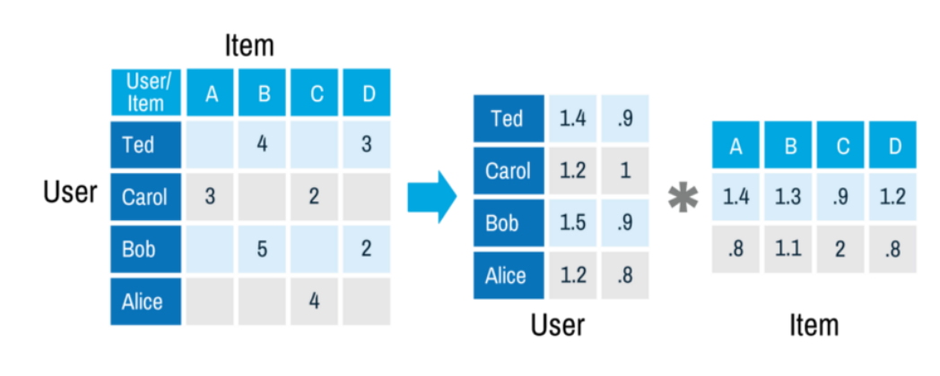
So we can approximate x (grade from i-th user to j-th film) with dot product of u and v. We build these vectors by the known scores and use them to predict unknown grades. For example, after matrix decomposition we have vector (1.4; .9) for Ted and vector (1.4; .8) for film A, now we can restore the grade for film A−Ted just by calculating the dot product of (1.4; .9) and (1.4; .8). As a result, we get 2.68 grade

Slide 15
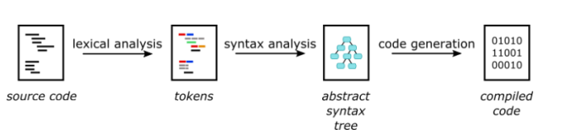
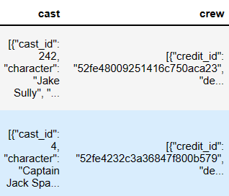
Abstract Syntax Tree (AST)
ast.literal_eval: A Python library function that can evaluate a string containing a Python expression.
literal_eval method is one of the helper functions that helps traverse an abstract syntax tree.

Slide 16
TF-IDF
Term frequency — Inverse document frequency (TFIDF) is based on the Bag of Words (BoW) model, which contains insights about the less relevant and more relevant words in a document. The importance of a word in the text is of great significance in information retrieval.
Term Frequency: This measures the frequency of a word in a document. This highly depends on the length of the document and the generality of the word.
tf(t,d) = count of t in d / number of words in d
Document Frequency: This measures the importance of documents in a whole set of the corpus. This is very similar to TF but the only difference is that TF is the frequency counter for a term t in document d, whereas DF is the count of occurrences of term t in the document set N.
df(t) = occurrence of t in N documents
Inverse Document Frequency: IDF is the inverse of the document frequency which measures the informativeness of term t.
idf(t) = log(N/(df + 1))
tf-idf(t, d) = tf(t, d) * log(N/(df + 1))

Slide 17
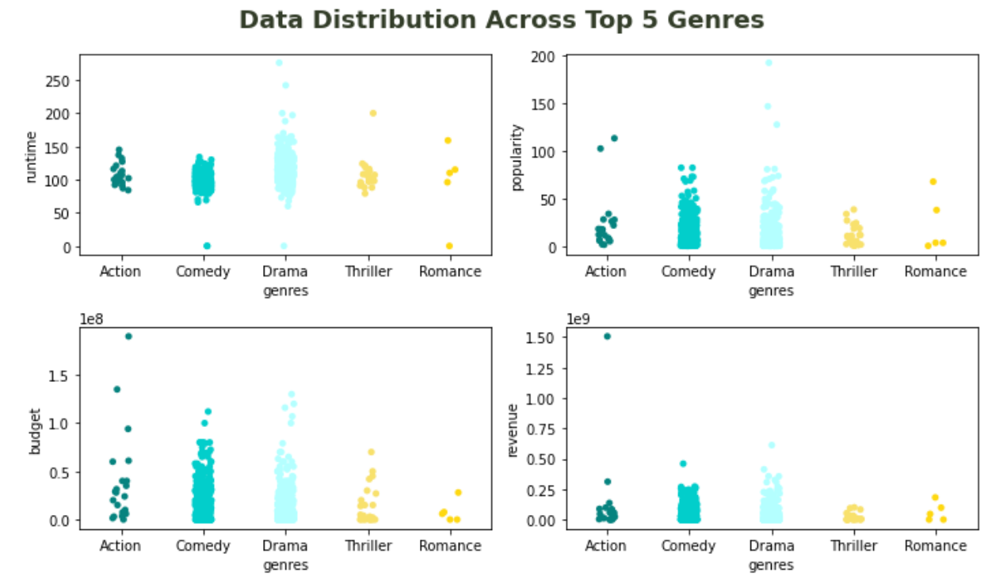

Slide 18
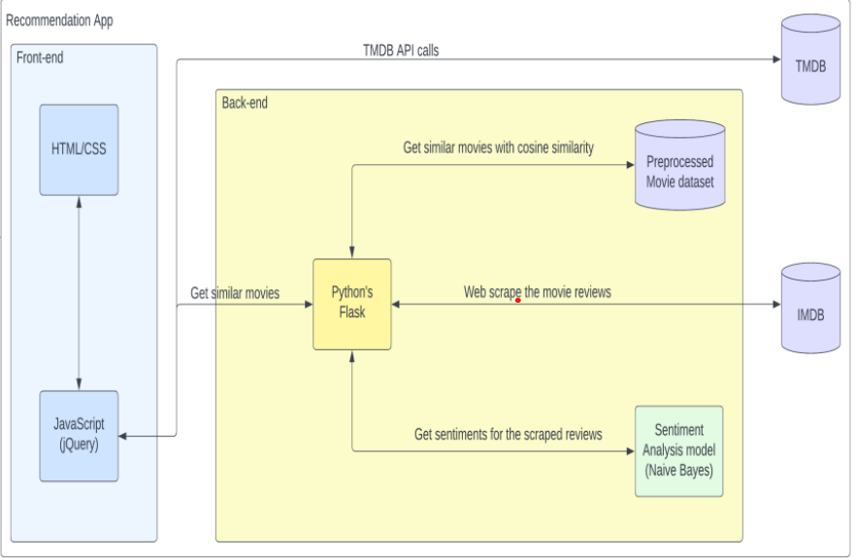
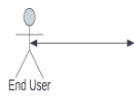
Recommendation app flow

Slide 19
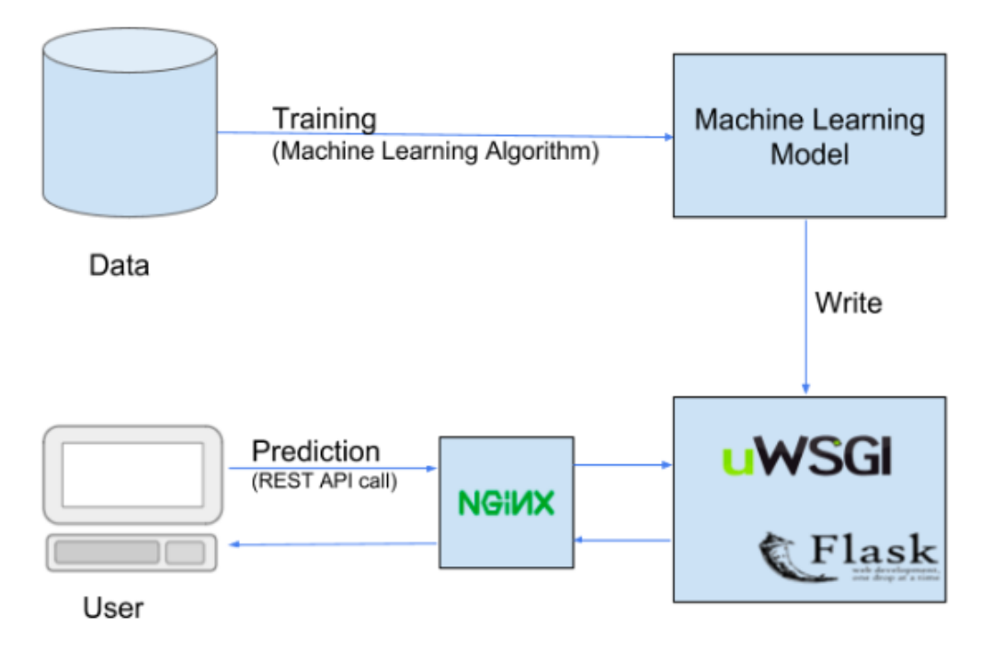
Flask Implementation
Flask is a web application framework written in Python. Flask is based on the Werkzeug WSGI toolkit and Jinja2 template engine.

Slide 20
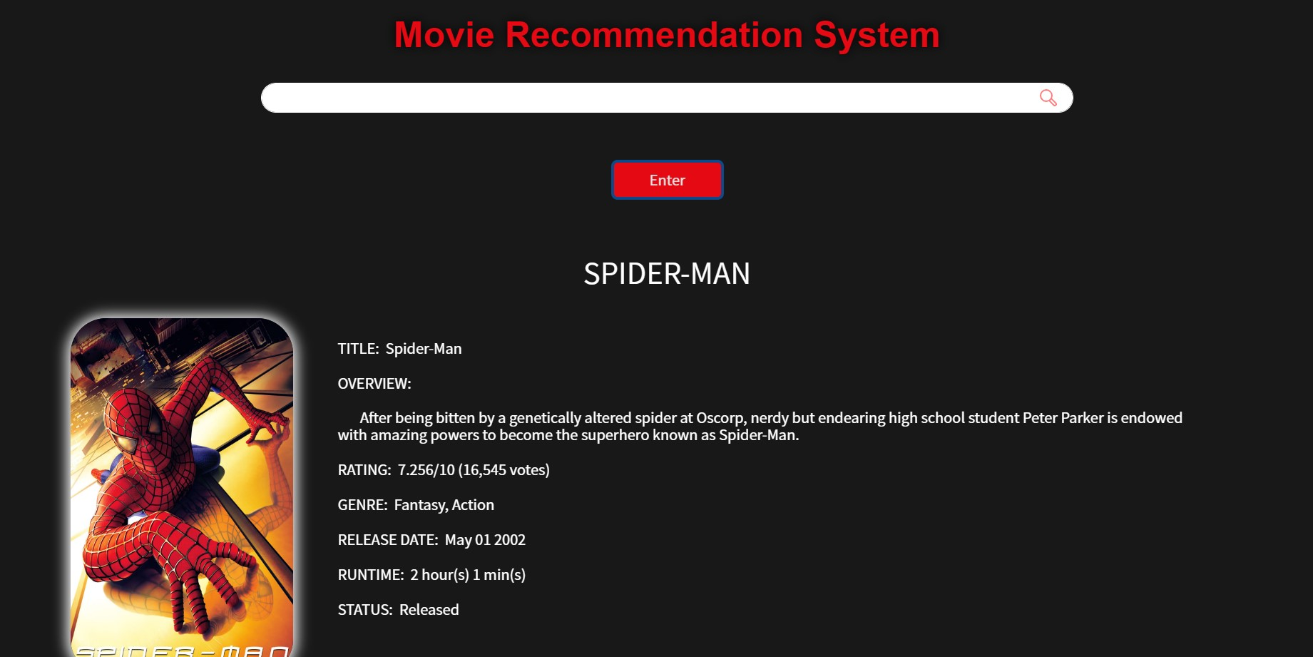

Slide 21
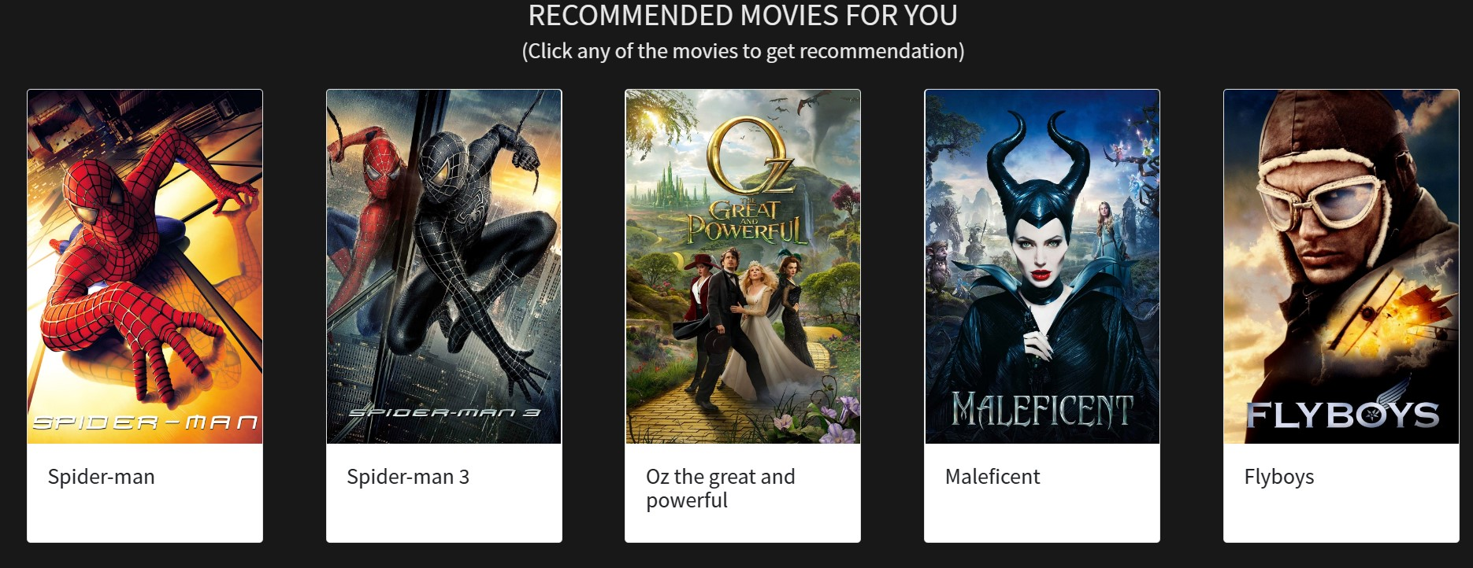

Slide 22
Conclusion
We conclude that movie recommendation system that combines both content-based and collaborative filtering techniques to provide users with accurate, personalized recommendations. It is capable of providing more accurate and detailed results than either technique alone, making it an ideal choice for movie recommendation systems. The hybrid-based system also has the capability to take into account user preferences and contextual information to provide more tailored and relevant results. By taking into account both user preferences and content-based information, the hybrid-based system is able to generate more accurate and meaningful recommendations.

Slide 23

Thank you

